Slide 1


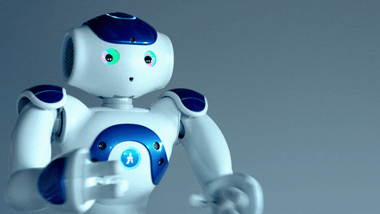
Welcome To G-Tec Computer Education, Nagercoil.

Slide 2

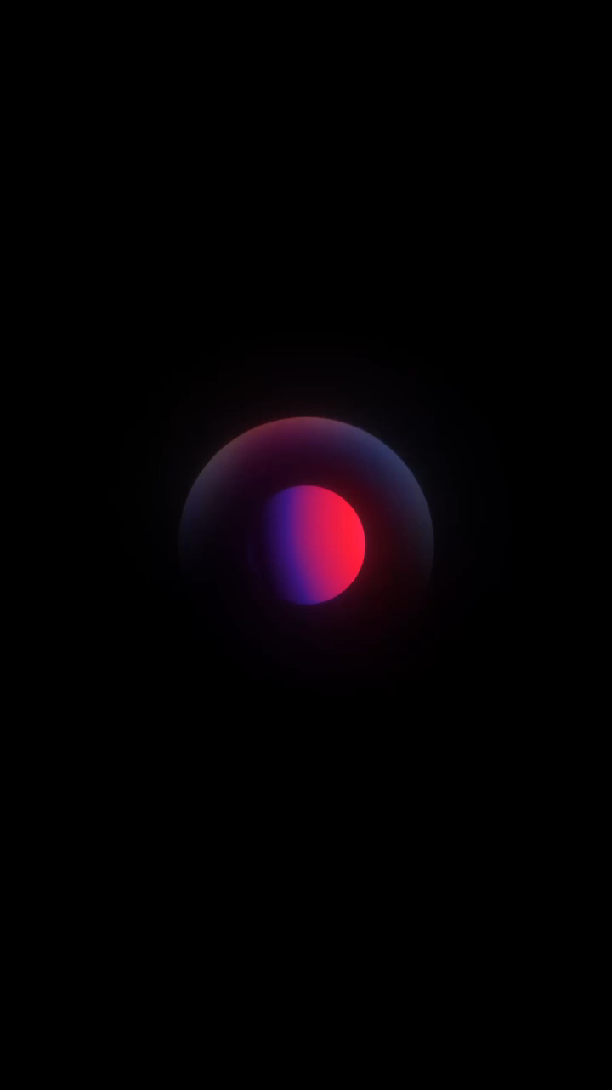

REACT
2
+
2
+

Slide 3

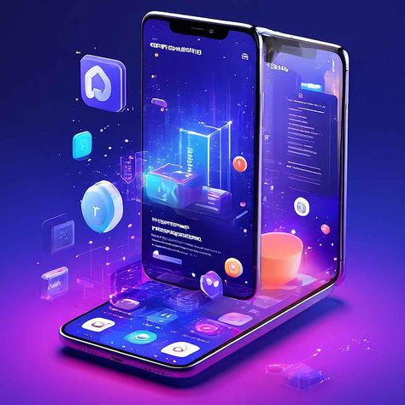

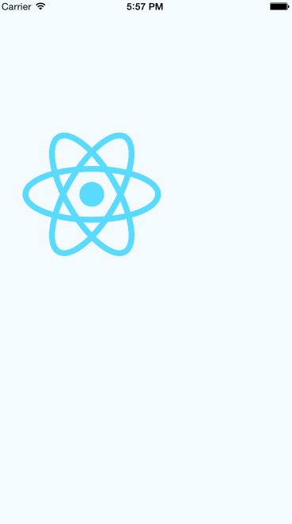
2
+

Slide 4
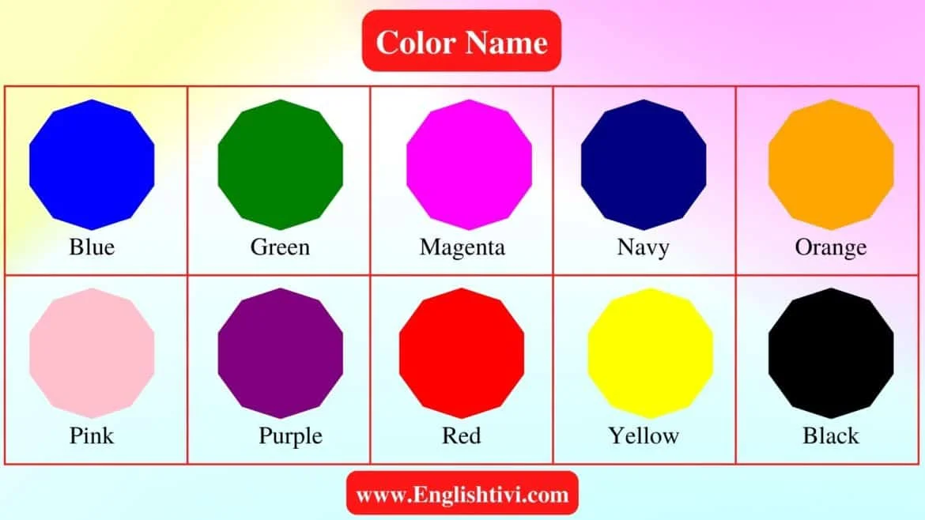

Slide 5
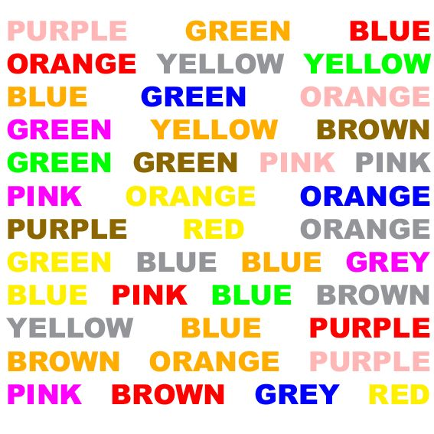

Slide 6
WHAT IS REACT?
React is a JavaScript library created by Facebook
React is a User Interface (UI) library
React is a tool for building UI components

Slide 7
Before you start, you should have a basic understanding of:
What is HTML
What is CSS
What is DOM
What is ES6
What is Node.js
What is npm

Slide 8
What is User Interface (UI)
A user interface (UI) is the point of communication between a person and a machine.
It's what you see, hear, say, and touch in order to give instructions to a device or receive information back from it.
React is widely used for building user interfaces due to its component-based architecture, fast rendering making it a popular choice for web and mobile app development.

Slide 9
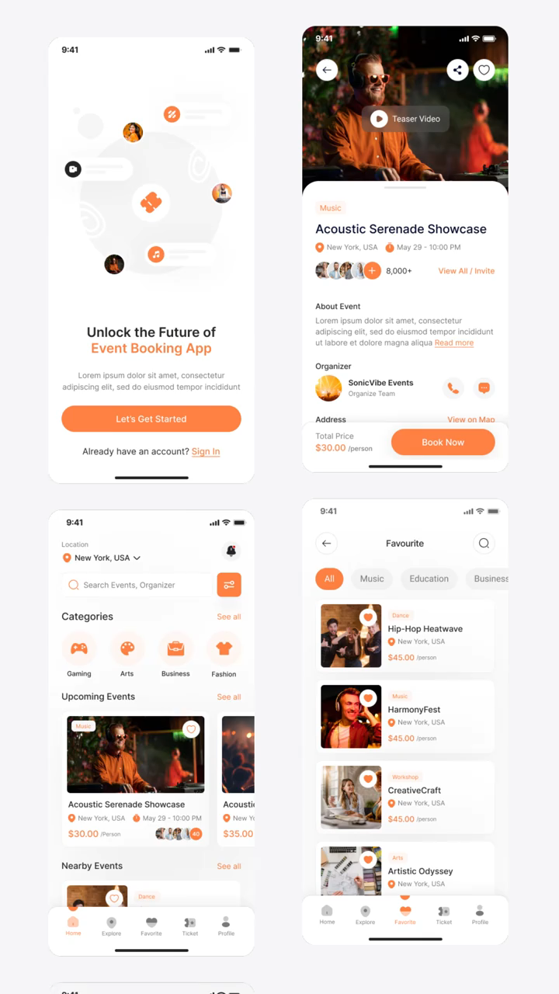
What is User Interface (UI) library
A UI (User Interface) library is a collection of pre-designed and pre-coded components (like buttons, forms, navigation menus, and icons) that developers can use to create user interfaces for websites

Slide 10
HISTORY OF REACT
React was created by Jordan Walke.
Initial Release Date: 2013
Current and ongoing version is React 19 : 2022

Slide 11
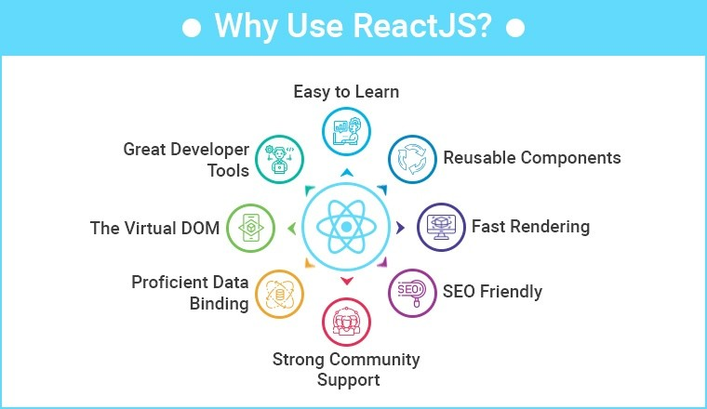

Slide 12
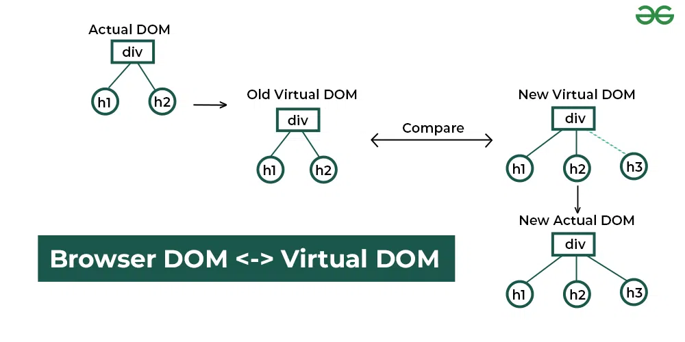

Slide 13

Why learn react?
React is widely used in web development.
Demand for React developers is high.
job opportunities and potentially higher salaries.
Reusable components and faster development can save time and money.

Slide 14
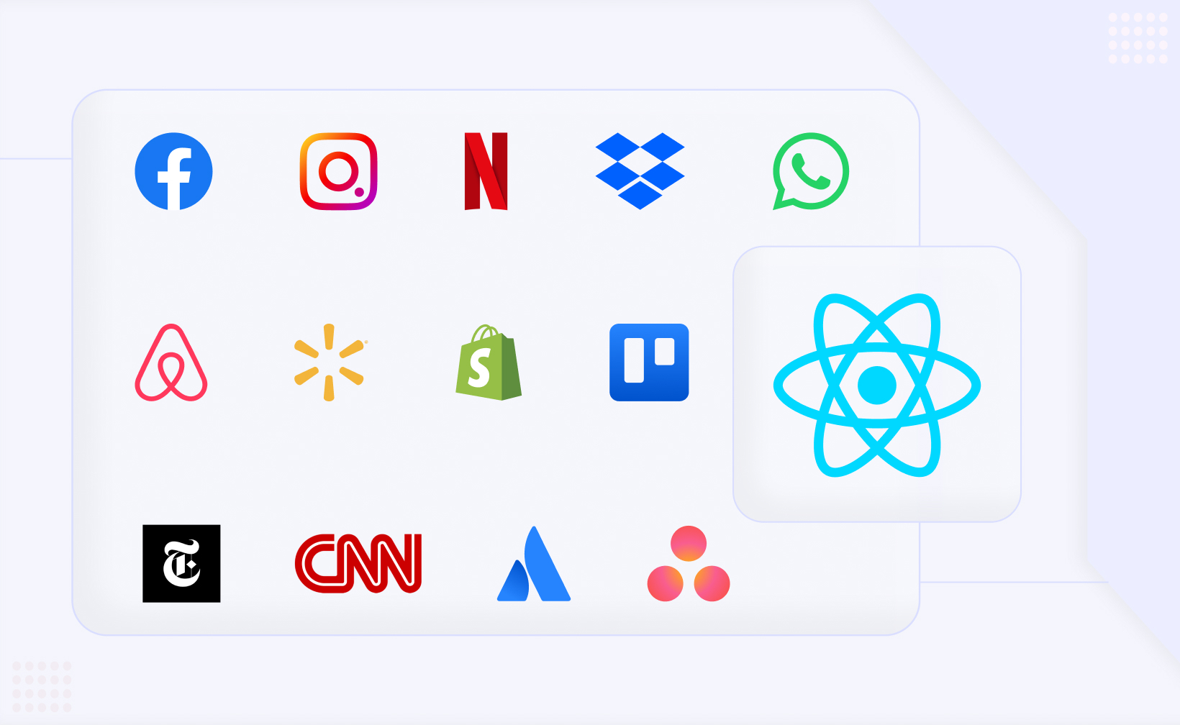
Top 13 React Apps: Popular Apps Built with React

Slide 15
What is the benefit of learn react
Creating dynamic and Interactive Interfaces.
Code Reusability and Maintainability.
Efficiency and Performance.
Career Opportunities.

Slide 16

G-TEC COMPUTER EDUCATION CENTRE is the largest computer education network with more than 900 global centers. We are committed to IT services, powered by a team of dedicated professionals with distinct experience in the technical, management & functional domains.

Slide 17


WE ARE SERVING
24 COUNTRIES

Slide 18


CORPORATE OFFICE G-TEC COMPUTER EDUCATION CENTRE ,Singapore

Slide 19

Agenda

Slide 20
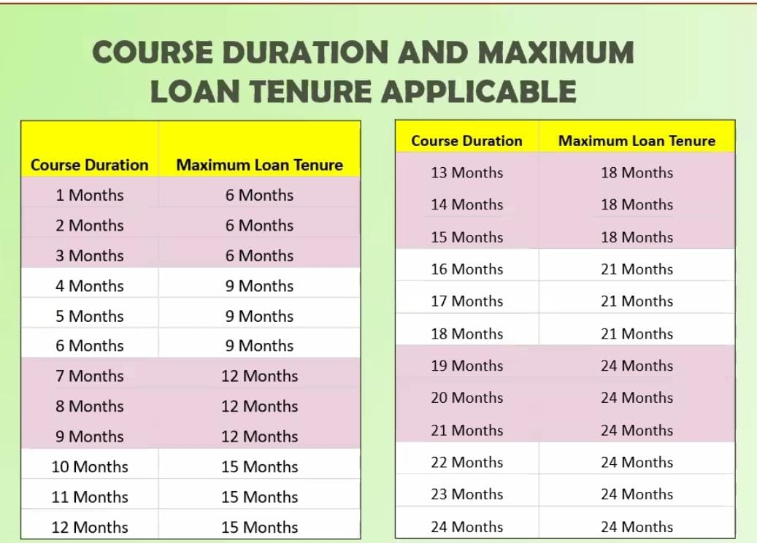

Slide 21
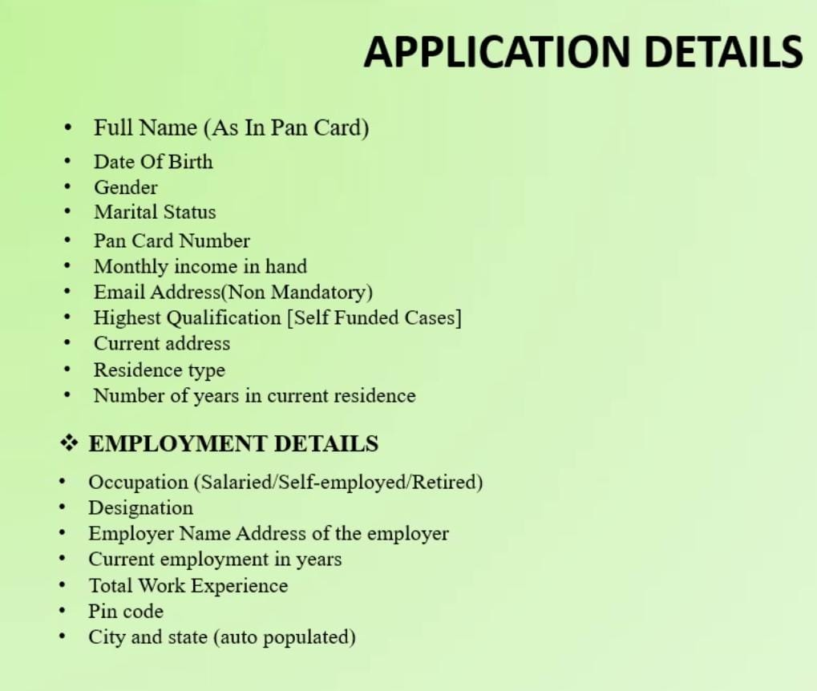

Slide 22
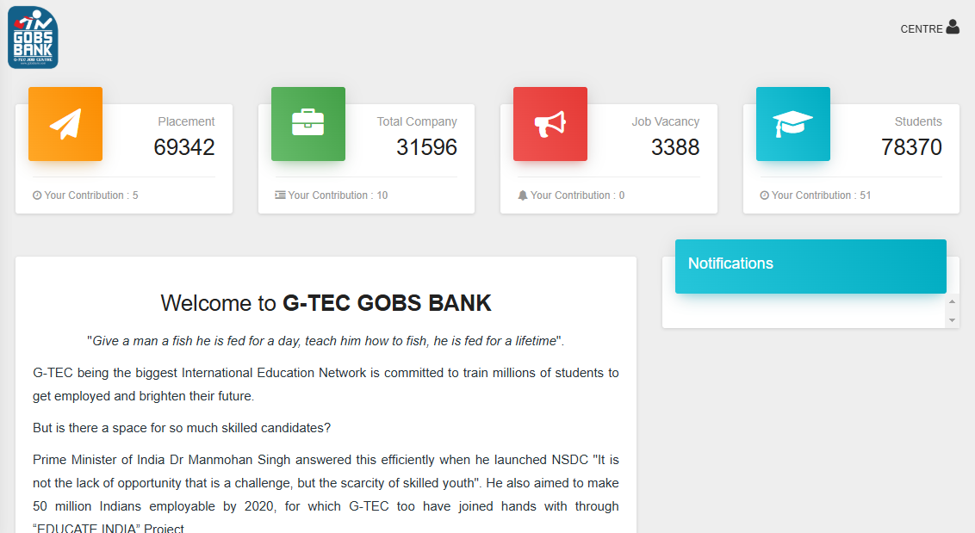

Slide 23
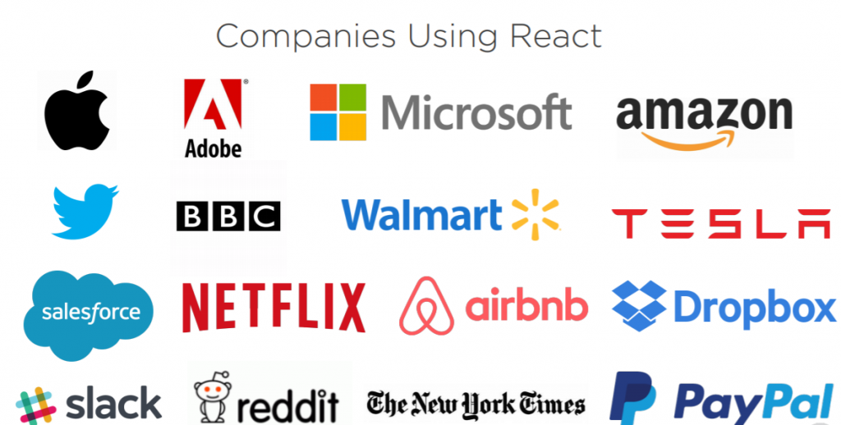

Slide 24
EXAMPLE: App.js
import React from 'react';
function App() {
return (
<div className="App">
<h1 style={
{ textAlign: 'center' }
}>
Hello, World!
</h1>
</div>
);
}
export default App;

Slide 25
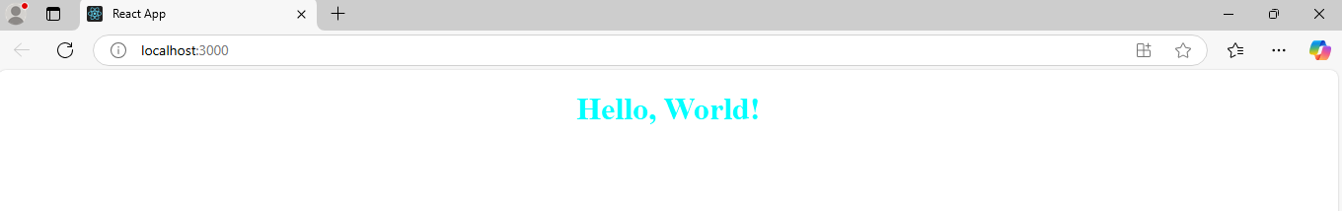
App.css
.App{
text-align: center;
color: aqua;
}

Slide 26

Do you have any queries?

Slide 27



